Slide 1


Smart Health Care Monitoring System Based on IoT
Group: 04
Members: Mashruf Mahabub-1510501042
Ibrahim Khalil-1520775042
Mostafijur Rahman-1611633042

Slide 2
Introduction
Everyday many lives are affected because the patients are not timely and properly operated.
Real time parameter values are not efficiently measured.
Sometimes it becomes difficult for hospitals to frequently check patient’s conditions.
Continuous monitoring of ICU patients is very difficult.

Slide 3
Introduction
This system is designed to be used in hospitals and homes also for measuring and monitoring various parameters like temperature, ECG, heart rate, blood pressure.
Our system is useful for monitoring health system of every person through easily attach the device and record it.

Slide 4
Objectives
Operate patients timely and properly.
Efficiently measure the parameter value in clinics as well as in hospitals.
Enable individual to improve health related risks and reduce healthcare costs.
Measure and monitor various parameters like temperature, ECG, heart rate, blood pressure.

Slide 5
Tools
Ardiuno IDE
Android Studio
Google FireBase

Slide 6
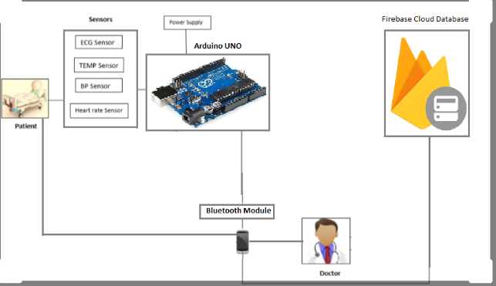
Block Diagram

Slide 7
Equipment And Budget
Item | Cost
Arduino Uno | BDT 400
HC-05 Bluetooth Module | BDT 250
LM35 Temperature Sensor | BDT 100
Humidity Sensor | BDT 350
Pulse Rate Sensor | BDT 600
Push Button | BDT 5
10k Resistor | BDT 5
Male-Female Wires | BDT 50
Jumper Wires | BDT 50
Breadboard | BDT 85
LED | BDT 5
Total | BDT 1900

Slide 8
Time Plan
Serial | Description
Task 1 | Arduino UNO & Arduino IDE setup and connect to the PC.
Task 2 | Setup the components and connect the wires.
Task 3 | Design an Android app.
Task 4 | Connect the bluetooth module with the smartphone.
Task 5 | Using Google Firebase make the application succeed.
Task 6 | Arduino IDE coding.
Task 7 | Check sensors one by one and collect all the data.
Task 8 | Make a database.
Task 9 | Connect everything.
Task 10 | Finalizing and testing.
Task 11 | Fix bugs (if any).

Slide 9
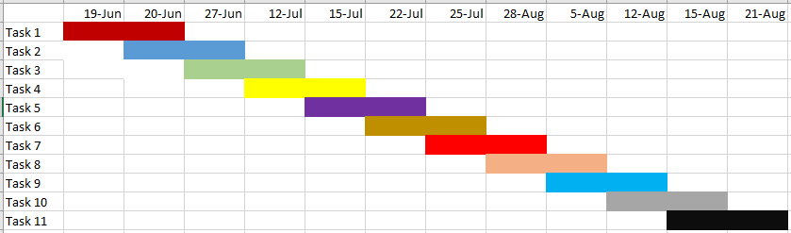
Grantt Chart

Slide 10
Scope
This project mainly finds it use in the field of medical diagnosis, in a country like Bangladesh where rural population and remote areas play an important role.
It is important to have an effective and on-time diagnosis system. We can make the whole diagnosis process better by introducing this idea.
We can also add many other devices like ECG sensor , BP sensor etc.

Slide 11
Outcome
No need to monitor from relay room.
Provide a healthy and sound health.
Save time.
Save money.
Save men work.

Slide 12
THANK YOU!
ANY QUESTION?

